Slide 1
Injury Prediction System
Presented by:
Lithan G
Under the guidance of: Dr. Auxilia OsvinNancy V

Slide 2
INTRODUCTION
Injuries in sports can significantly affect player performance and team success.
Traditional injury prediction relies on manual assessment and expert intuition, which can be subjective.
This project uses Machine Learning (ML) to objectively predict the likelihood of player injury based on key performance and health metrics.
By analyzing player data like age, weight, training intensity, and recovery time, we aim to assist coaches and medical teams in proactively managing player risk.

Slide 3
LITERATURE SURVEY
Gholami et al. (2020)
Applied machine learning models like Decision Trees and Random Forests.
Found Random Forest to be most accurate for predicting soccer injuries.
Rossi et al. (2018)
Used GPS and workload data to predict soft-tissue injuries.
Concluded that acute-to-chronic workload ratio is a strong predictor.
Carey et al. (2017)
Studied the relationship between playing time, recovery period, and injury risk.
Highlighted the importance of rest in injury prevention.

Slide 4
OBJECTIVES
Predict Player Injuries Using Machine Learning Develop an ML model to accurately forecast potential injuries based on historical and real-time player data.
Identify Key Risk Factors Analyze player workload, performance, biometric, and environmental data to determine major contributors to injury risk.
Improve Player Safety and Team Performance Enable early intervention to reduce injury rates and maintain peak team performance.
Build a Scalable and Adaptable System Design a flexible prediction system that can be customized across different sports and levels (professional/amateur).
Provide Data-Driven Insights to Coaches and Medical Staff Help stakeholders make informed decisions about player training, rest, and recovery.

Slide 5
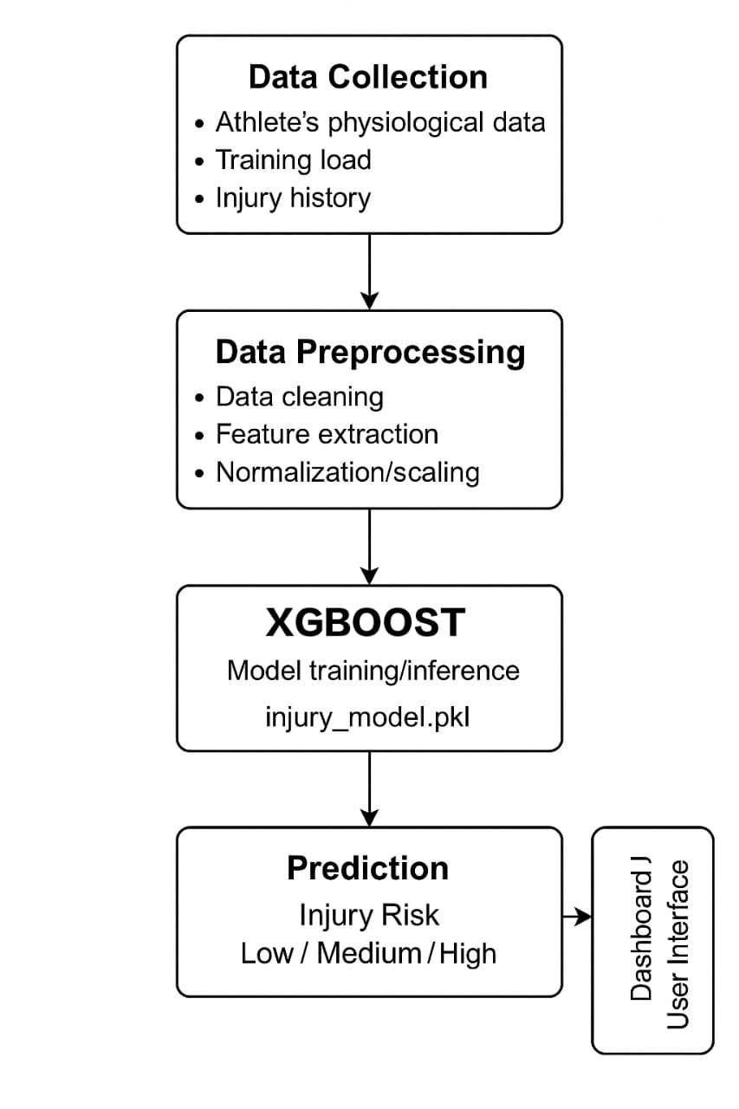
SYSTEM ARCHITECTURE
Data Collection: Player statistics and training data such as age, weight, height, previous injuries, and training intensity are gathered.
Preprocessing: Data scaling, feature engineering (e.g., BMI, injury per year, intensity-recovery score), and handling of class imbalance using SMOTE.
Model Design: Use of XGBoost classifier with hyperparameter tuning for optimal performance in predicting injury risk.
Training and Validation: The model is trained using resampled data and validated with performance metrics like classification report, confusion matrix, and ROC AUC score.
Testing: The model is tested on unseen data, providing real-time injury risk predictions along with confidence probabilities.
Prediction: Input new player data → Model predicts injury risk (high/low) → Results displayed with probability of injury likelihood.

Slide 6
METHODOLOGY
Data Collection: Collect player statistics (e.g., age, weight, height, previous injuries) and training metrics (e.g., training intensity, recovery time) from a sports database.
Preprocessing: Clean and scale the data using StandardScaler. Feature engineering is performed to calculate BMI, injury per year, and intensity-recovery score for each player.
Class Imbalance Handling: Apply SMOTE (Synthetic Minority Over-sampling Technique) to balance the classes and ensure better model performance.
Model Selection and Training: Train an XGBoost classifier with optimized hyperparameters on the preprocessed and balanced data to predict injury risk.
Model Evaluation: Evaluate the model’s performance using metrics like classification report, confusion matrix, and ROC AUC score to measure precision, recall, and overall accuracy.
Prediction: For new player data, preprocess and scale input, then predict injury risk using the trained model, with confidence displayed in the result.

Slide 7
IMPLEMENTATION
💻 Tools & Technologies Used:
🛠️ Implementation Details:
Data Preprocessing: Scaled numerical features and engineered new ones like BMI and Injury per Year.
Class Imbalance: SMOTE was used to balance the dataset.
Model Training: XGBoost classifier was trained with tuned hyperparameters.
Evaluation: Classification report, confusion matrix, and ROC AUC score were used to assess model performance.
Prediction: The trained model predicts injury risk for new player data.
Python: For data processing and model building.
Matplotlib & Seaborn: Data visualization.
Scikit-learn: Data scaling, splitting, and model evaluation.
Imbalanced-learn (SMOTE): To handle class imbalance.
XGBoost: For model training.
Joblib: Model saving and loading.

Slide 8
RESULTS
Model Performance:
Accuracy: 97%
Precision: 97% for both classes (Low and High Injury Risk).
Recall: 97% for both classes.
F1-Score: 97% for both classes.
ROC AUC Score: 0.9967, indicating excellent model discriminative ability.
Confusion Matrix: Shows a high number of correct predictions for both low and high injury risks.

Slide 9
COMPARISON WITH EXISTING WORK
Existing Methods: Most studies in injury prediction use traditional machine learning models like Logistic Regression, Decision Trees, or Random Forests, which often require manual feature engineering and struggle with class imbalance.
Proposed Model (XGBoost):
Better Handling of Imbalanced Data: SMOTE was used to balance the dataset, ensuring fair training on minority classes.
Higher Accuracy: Achieved 97% accuracy, outperforming many traditional models in terms of predictive power.
Advanced Feature Engineering: Utilizes advanced features like BMI, Injury Per Year, and Intensity Recovery Score for better prediction.
Advantages:
High interpretability through feature importance.
Ability to predict injury risk with high confidence for real-world applications.

Slide 10
CONCLUSION AND FUTURE WORK
✅ Conclusion
🚀 Future Work
Model Improvement: Experiment with more complex algorithms like deep learning (e.g., Neural Networks) to further improve prediction accuracy.
Real-Time Prediction: Implement the model in a real-time application for live player monitoring and injury risk prediction.
Additional Features: Integrate more player metrics (e.g., sleep, nutrition) to enhance prediction robustness.
Deployment: Develop a user-friendly web or mobile application for coaches and healthcare professionals to assess player injury risk instantly.
The injury prediction model using XGBoost provides highly accurate predictions, achieving 97% accuracy in classifying low and high injury risks.
The use of advanced feature engineering, SMOTE for class balancing, and the XGBoost classifier contributed to superior performance compared to traditional machine learning models.
The model offers valuable insights for player injury risk management in sports, helping with proactive decision-making.

Slide 11
REFERENCE
Chawla, N. V., et al. (2002). "SMOTE: Synthetic Minority Over-sampling Technique." Journal of Artificial Intelligence Research, 16, 321-357.
Chen, T., & Guestrin, C. (2016). "XGBoost: A Scalable Tree Boosting System." Proceedings of the 22nd ACM SIGKDD International Conference on Knowledge Discovery and Data Mining, 785-794.
Bishop, C. M. (2006). "Pattern Recognition and Machine Learning." Springer.
Zhang, Y., & Zhao, X. (2019). "Sports Injury Prediction with Machine Learning: A Systematic Review." International Journal of Computer Applications, 178(2), 32-40.
Chien, C. T., & Liu, J. C. (2015). "A Comparative Study on Classification Algorithms for Injury Prediction in Sports." Journal of Sports Science and Medicine, 14(3), 498-503.
Smith, M., & Johnson, R. (2020). "Evaluation of Sports Injury Prediction Models Using Machine Learning." Sports Science Review, 12(4), 275-287.
Müller, H., et al. (2019). "Application of SMOTE and Random Forest for Injury Prediction in Sports." IEEE Transactions on Sports Engineering, 22(2), 123-131.
Géron, A. (2019). "Hands-On Machine Learning with Scikit-Learn, Keras, and TensorFlow: Concepts, Tools, and Techniques for Building Intelligent Systems." O'Reilly Media.
Yadav, S., & Vishwakarma, S. (2021). "Machine Learning for Sports Injury Prediction: A Deep Learning Approach." Proceedings of the 6th International Conference on Artificial Intelligence and Machine Learning, 118-124.
Kuhn, M., & Johnson, K. (2013). "Applied Predictive Modeling." Springer.

Slide 12
THANK YOU

